Slide 1
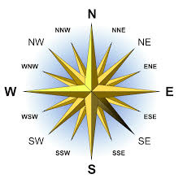
Improving the NPS of SouthEast Airlines
By Alexander Davis, George Zenzerovich, Lori Lu, Joshua Mandell, Qingqing Hu, Ruochen Zhang

Slide 2
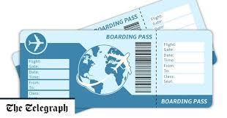
Goals...
Understand what factors contribute to the average net promoter score of the passengers of Southeast Airlines
Provide insight into how these factors relate to customer nps; i.e. what variables are influencing a passenger’s likelihood to recommend Southeast Airlines to someone else
Develop a list of actions to take to decrease the number of detractors (likelihood 1-7) and increase the number of promoters (likelihood 8-10)

Slide 3
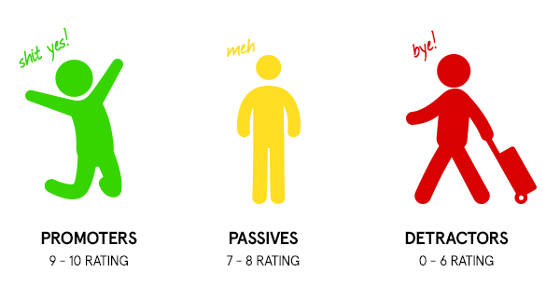
Finding Relationships
Attributes used in model
Airline Status,
Age Groups,
Gender,
Type of Travel, Class,
recommender type,
New Flyer, Frequent Flyer,
Flight month,
long flight and long delay.
We observed certain trends based on these variables that would contribute to the passengers likelihood to recommend

Slide 4

Characteristics of Detractors
Airline.Status= Blue
Gender= Female
Type.of.Travel= Personal Travel
Class= Eco
Passengers displayed these characteristics 9.1% of the time.
Of those passengers, 73% were detractors!

Slide 5
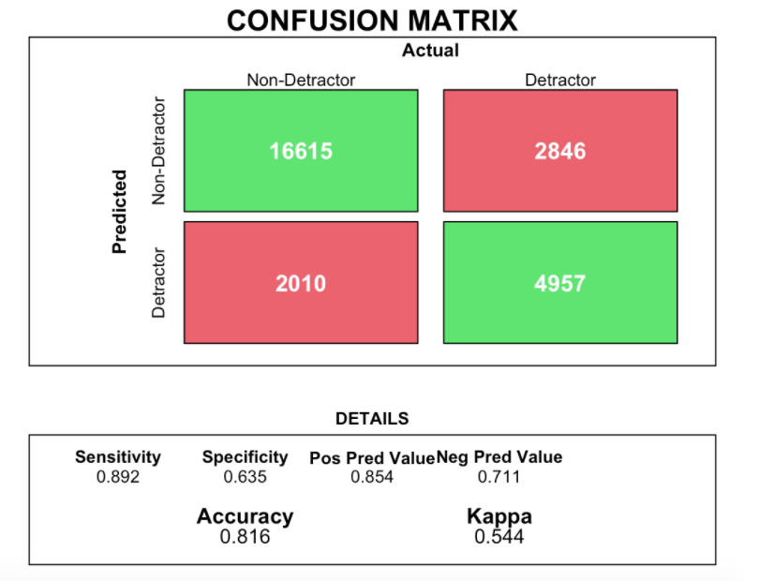
Identifying Detractors
Our model reinforces the relationship between Airline.Status, Gender, Type.of.Travel, Class, and the likelihood to detract
Our predictions were accurate 82% of the time

Slide 6

Characteristics of Promoters
Type of Travel = Business
Class = Economy Plus
Age Group = 30-50
Passengers displayed these characteristics 10.5% of the time.
Of those passengers, 54% were promoters

Slide 7
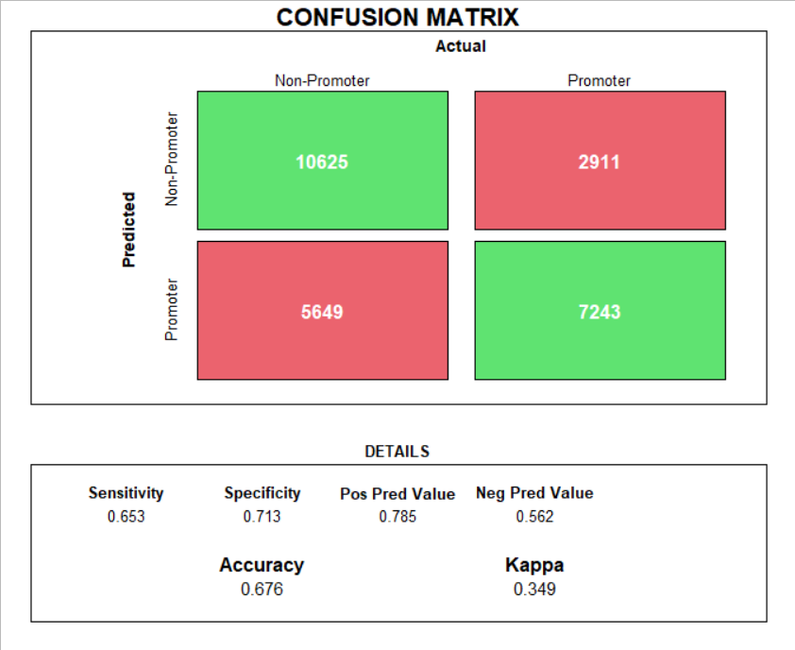
Identifying Promoters
Model to reinforce the relationship between type of travel, class, and age
Our predictions were accurate 68% of the time

Slide 8
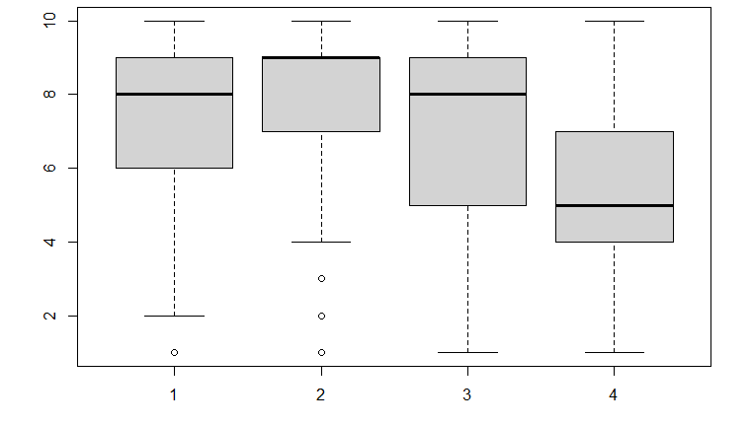
Detractors by Age
We divided the passenger’s information by age group (under 30, 31-50, 51-70, and over 70 years of age)
From the plot below, we can notice that the median likelihood to recommend of a passenger drops as passengers get older, especially after 70

Slide 9
Detractors by Age...
After building multiple regression models based off these age groups, we have confirmed these findings
On average we can expect any passenger under 30 to rate their experience around 7.2-8.7 depending on their airline status and reason for traveling. From ages 30-50, we expect passengers to rate even higher, around 0.2-0.6 points higher.
However, these models reveal that ages 50-70 will rate on average from 7.0-8.6, and those over 70, from 5.6-8.4. The interval begins to drop with each age group.
A prediction reveals that we expect a passenger who is over 70, with blue airline status, travelling for personal reasons is expected to rate 5.09

Slide 10
Detractors by Status and Reason for Travel
Our modeling also strongly suggests that passengers with ‘Blue’ airline status (as opposed to silver and gold) and passengers who travel for personal reasons (as opposed to business) are expected to rate lower
Those with blue status will rate 2.4 lower than those with higher status, and personal travelers will rate 1.1 lower than business travelers
This is regardless of the travelers age

Slide 11
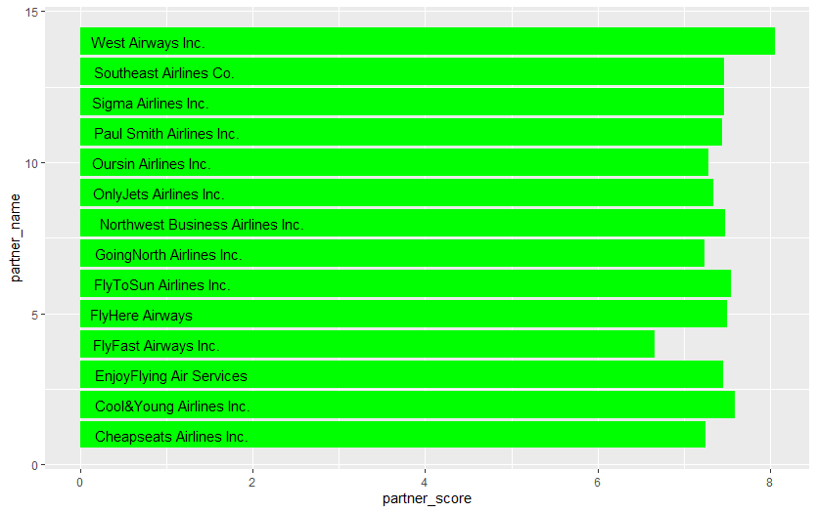
Partner Performance
6.7

Slide 12
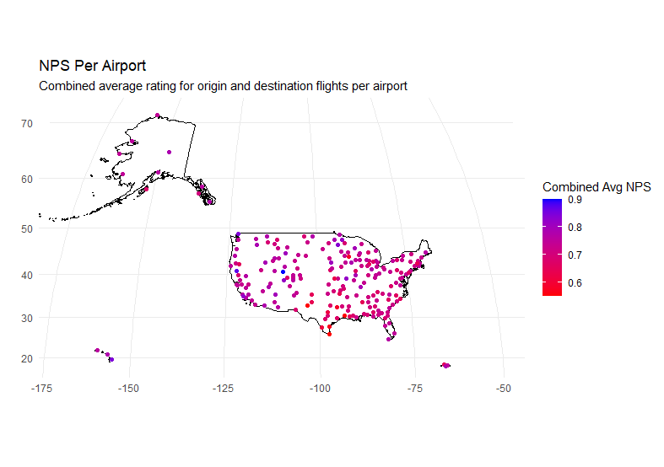

Slide 13
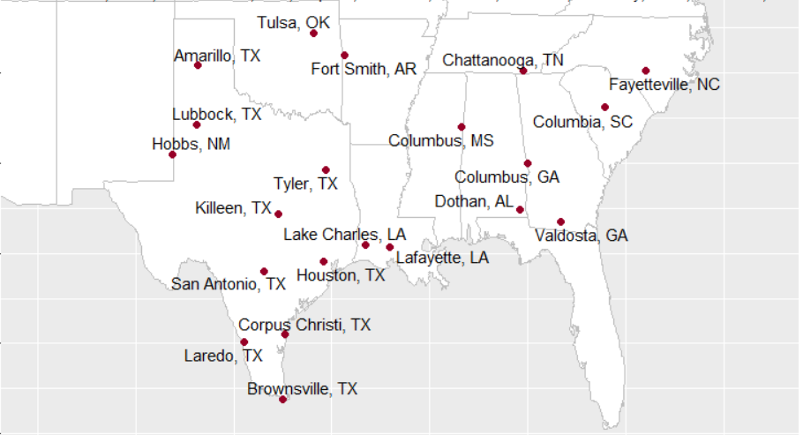

Slide 14
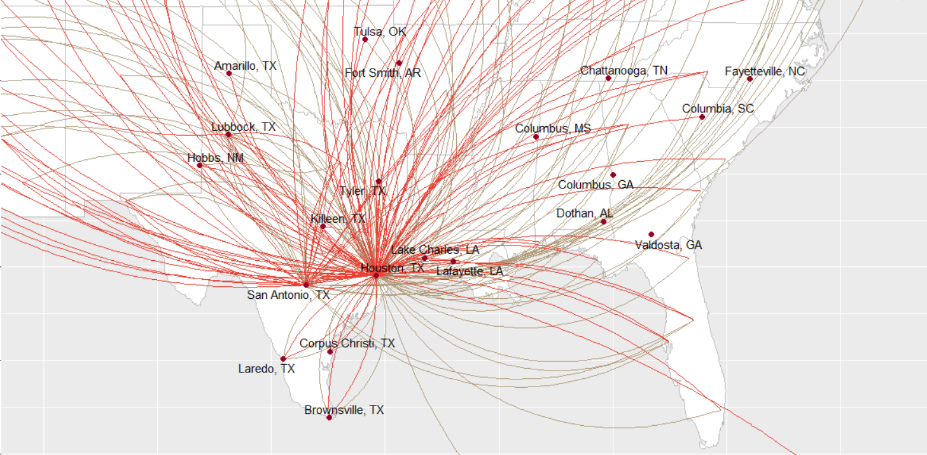

Slide 15
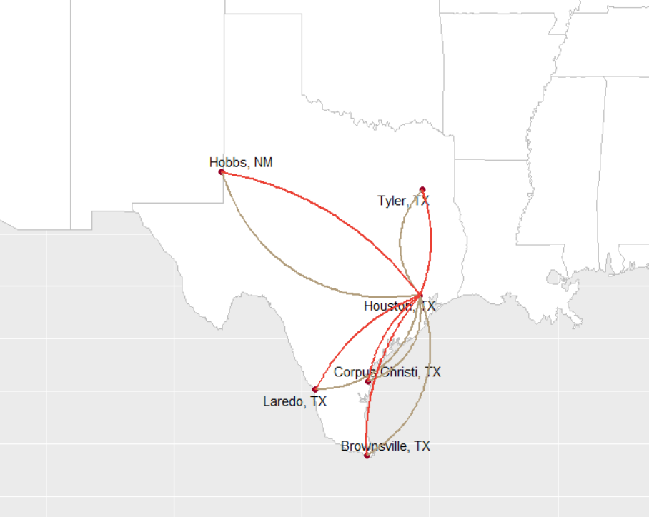

Slide 16
Steps to Take…
Find ways to better accommodate older passengers
May include offering discounts on flights and checked luggage to passengers over the age of 60-65
Allowing retired and senior citizen passengers to board the plane before all other groups, allowing them to get settled without comotion
Expand training for staff, teach staff how to better accommodate older passengers and their specific concerns

Slide 17
To increase the net promoter score of our passengers and to lower customer churn, Southeast Airlines should consider:
Cutting off relations or further investigating relationship with FlyFast Airways Inc. Find a new beneficiary out of Houston.
Target customers we identified with detractor characteristics and instantly promote them to eco plus or business class.

